Slide 1
Adidas Sales Performance Dashboard
By BENJAMIN oNYEKWERE

Slide 2
🔍 Project Overview: Adidas Sales Dashboard
Objective:
This interactive dashboard presents an analysis of Adidas sales performance across various regions, products, retailers, and time periods. It offers insights into the best-selling and fastest-growing products, as well as identifying the regions with the highest and lowest performance.

Slide 3
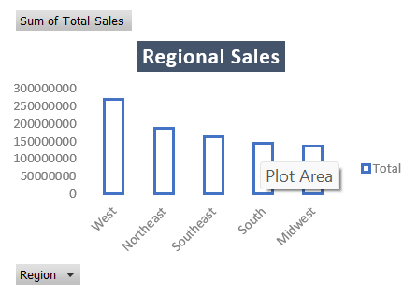
REGIONAL SALES:
Western region is the top performer with the highest number of sales.
Midwest region is the lowest performer with the lower number of sales

Slide 4
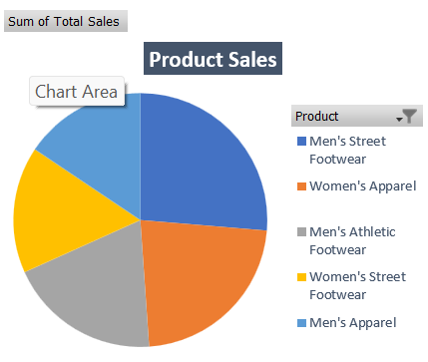
PRODUCT SALES
Men's street footwear emerged as the highest-performing product, driven by strong sales figures. In contrast, women's athletic footwear ranked lowest among the top five products based on sales performance.

Slide 5
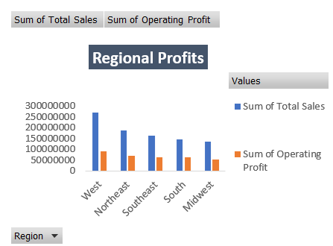
REGIONAL PROFIT
The West region leads in total sales, generating $269,943,182—nearly double that of the Midwest region. However, its profit margin stands at 33.2% ($89,609,516 out of $269,943,182), which is lower than the Midwest's 38.9% ($52,811,412 out of $135,800,182). This indicates that while the West achieves higher sales, the Midwest is more efficient in terms of profitability.

Slide 6
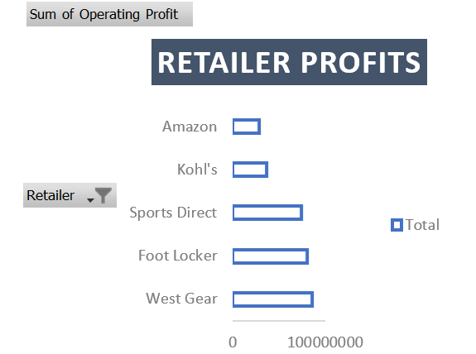
RETAILER PROFITS
Foot Locker demonstrates a significantly higher profitability compared to Amazon, earning $18,245,550 in profit versus Amazon’s $6,833,803. This means Foot Locker’s profits are roughly 2.67 times greater than those of Amazon.

Slide 7
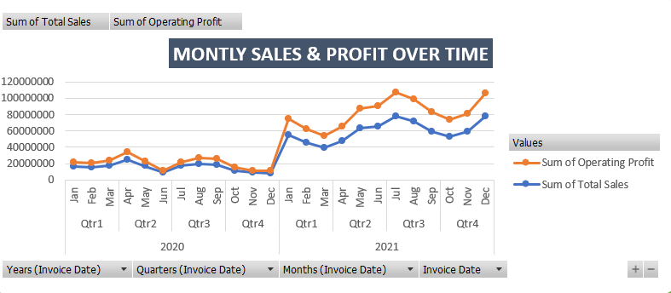
MONTLY SALES & PROFITS OVER TIME
Both sales and profit follow a similar trend, indicating consistent profitability relative
to revenue.
No significant drops or losses, indicating consistent market performance.
The proportionality of profit to sales across months suggests that profit margins remain
relatively stable.

Slide 8
RECOMMENDATION
Explore pricing adjustments in the West region to enhance profit margins while maintaining stable sales volume.
Initiate marketing campaigns focused on women's athletic footwear, showcasing its comfort and performance to drive sales growth.
Create tailored strategies for each region, taking into account their specific market conditions and cost structures, with the Midwest region prioritized due to its relatively low sales performance.
Investigate Market trends and competitive dynamics to understand why certain retailers are outperforming others.
- Assess Amazon's operational expenses and identify opportunities to enhance efficiency.

